Slide 1
CUSTOMER RETENTION ANALYSIS

Slide 2
Contents
Introduction To Data Analysis
Why Data Analysis is Needed?
Problem Statement
Steps Followed in Data analysis
Model Selection
Results and Conclusion

Slide 3
Data Analysis
Data analysis is a process of finding, collecting, cleaning, examining, and modeling data to derive useful information and insights and understand the derived information for data-driven decision-making.

Slide 4
Why Data Analysis is Needed?
Data analytics is the science of analyzing raw data to make conclusions about that information. Many of the techniques and processes of data analysis have been automated into mechanical processes and algorithms that work over raw data for human consumption.

Slide 5
Problem Statement
Customer satisfaction has emerged as one of the most important factors that guarantee the success of online store; it has been posited as a key stimulant of purchase, repurchase intentions and customer loyalty. A comprehensive review of the literature, theories and models have been carried out to propose the models for customer activation and customer retention.
Five major factors that contributed to the success of an e-commerce store have been identified as:
service quality
system quality
information quality
trust
net benefit
The research furthermore investigated the factors that influence the online customers repeat purchase intention. The combination of both utilitarian value and hedonistic values are needed to affect the repeat purchase intention (loyalty) positively.

Slide 6
Steps Followed in Data analysis
Define the business objective.
Source and collection of data.
Processing and cleaning the data.
Perform exploratory data analysis (EDA).
Select, build, and test models.
Monitor and validate against stated objectives.

Slide 7
Objective
The main objective of Customer retention is to find Which are the websites that most people recommend to others depending upon the customers satisfaction and trust on the particular site.

Slide 8
Source and collection of data.
Data collection is the process of gathering, measuring, and analyzing accurate data from a variety of relevant sources to find answers to research problems, answer questions, evaluate outcomes, and forecast trends and probabilities.
Some common sources or methods of collecting primary data are:
Interviews
surveys
questionnaires
experiments
observations.
Here The data is collected from the Indian online shoppers. Results indicate the e-retail success factors, which are very much critical for customer satisfaction.

Slide 9
Processing and cleaning the data
Processing of Data includes:
Importing Libraries that support the data analysis.
Loading the dataset to be analyzed.
The dataset contains 269 rows and 71 columns.
Data Cleaning
Data cleaning is done by removing the null values and filling it with either of mean, median, mode depending on the format of data.

Slide 10
Analyze the Target Variable:
The target variable is ‘Which of the Indian online retailer would you recommend to a friend?’.
It is a categorical variable. So it is visualized with count plot to see the distribution.
Here it is represented in pie chart to show the various choice of websites.

Slide 11
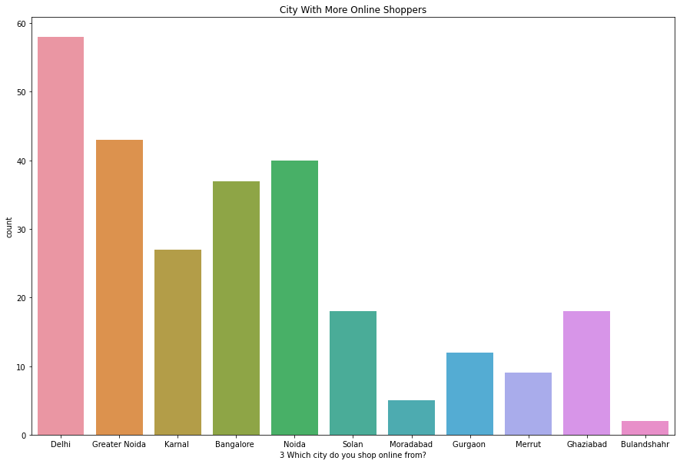
Check Correlation Between variables
Correlation between each columns are checked by plotting Count plot for each variable, since they are categorical type of data.
City with more online shoppers are seen from Delhi and least shoppers are from Bulandshahr.

Slide 12
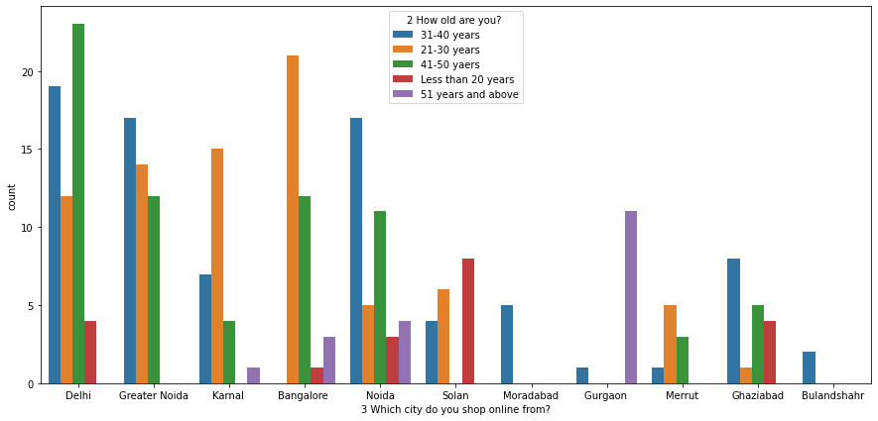
This shows the different age group of shoppers from various cities. People from age group of 21-30 prefer more online shopping.

Slide 13
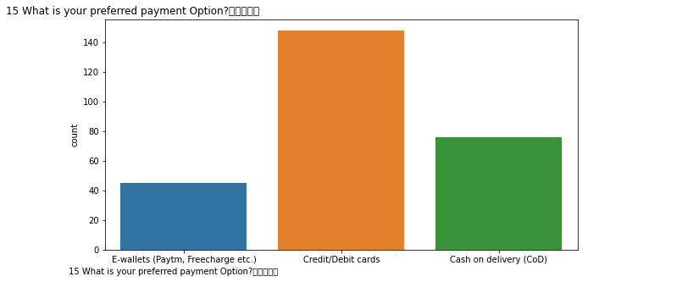
Some Observations from the plot:
For the past 1 year, most people have purchased less than 10 times.
Most shoppers use MOBILE INTERNET on SMART PHONES to make online purchase.
Widely used browser for online shopping is GOOGLE CHROME on WINDOWS

Slide 14
From the above observations, SEARCH ENGINES are the most favourite channel for online shoppers, even after shopping for the first time.
Before making an order, people search for more than 15 mins to fix it and the preferred method of payment is through CARD.
With effective ALTERNATIVE OFFERS people tend to ABANDOM the cart SOMETIMES.
People strongly recommend readability and understandability of the products and information on similar products and sellers for making a decision to purchase online.

Slide 15
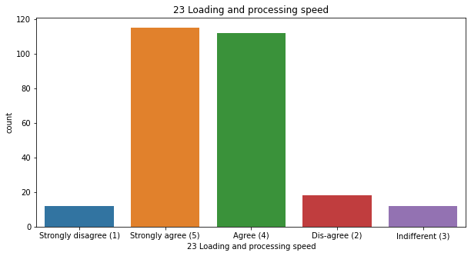
Frequent Online Shoppers strongly recommend:
Ease of Navigation
High processing speed
user friendly
convenient Payment
Empathy
enjoyment from online shopping

Slide 16
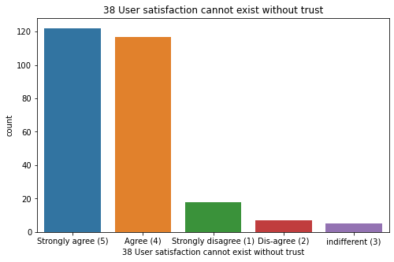
Most people strongly recommend: Convenient Shopping
with good returns policy
User satisfaction with trust
Monetary Savings.

Slide 17
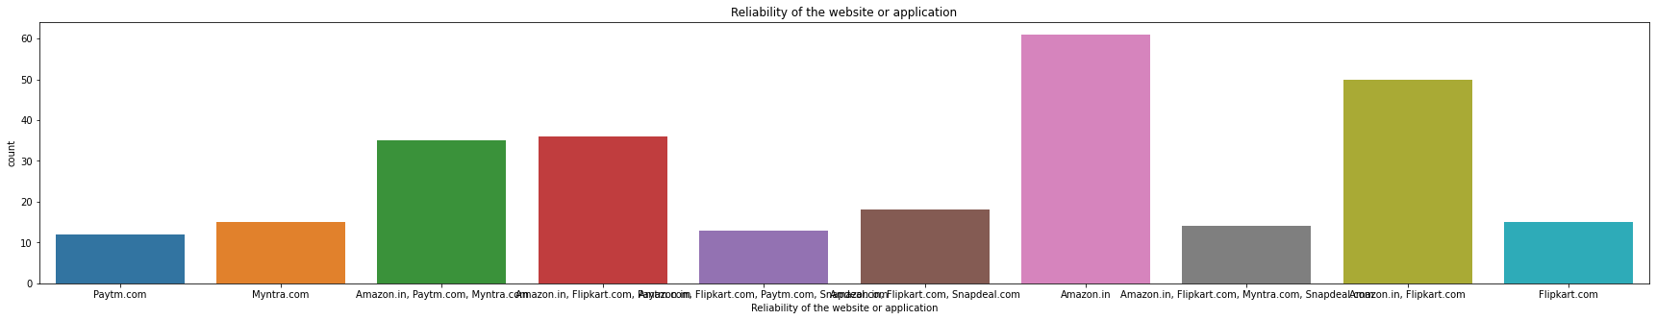
From the above insights, certain websites are being recommended by the customers based on different criteria. Mostly amazon.in and other combined websites.

Slide 18
Data Description
First, the data is encoded to make it to numerical type.
Description function provides the values like
Mean
Median
Mode
Maximum values
Minimum values
In certain columns, the mean values are deviated much from the median showing the presence of skewness.
In some columns the values of 75th percentile and maximum values are more indicating the presence of outliers

Slide 19
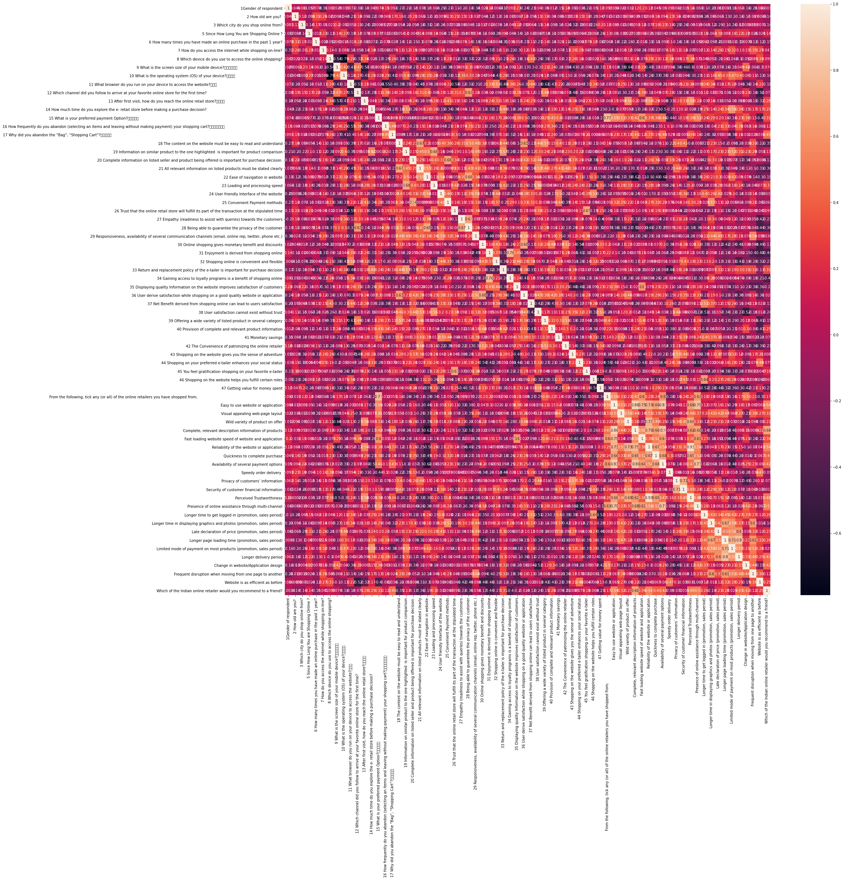
Correlation

Slide 20
The Correlation within each column is found and also awith the target variable is found.
VIF:
Then the columns with multicollinearity is found using Variance Inflation Factor.
Those columns that are closely related to eachother are removed based on its least contribution to the target variable.

Slide 21
Many columns have high collinearity within them.
So, certain columns are deleted based on its lowest contribution to the target variable.
The Columns are listed here.
'6 How many times you have made an online purchase in the past 1 year?',
'9 What is the screen size of your mobile device?\t\t\t\t\t\t ',
'11 What browser do you run on your device to access the website?\t\t\t ',
'12 Which channel did you follow to arrive at your favorite online store for the first time?
18 The content on the website must be easy to read and understand',
'22 Ease of navigation in website

Slide 22
'25 Convenient Payment methods',
'29 Responsiveness, availability of several communication channels (email, online rep, twitter, phone etc.)',
'31 Enjoyment is derived from shopping online',
'34 Gaining access to loyalty programs is a benefit of shopping online',
'35 Displaying quality Information on the website improves satisfaction of customers',
'39 Offering a wide variety of listed product in several category',
'40 Provision of complete and relevant product information',
'41 Monetary savings',
'45 You feel gratification shopping on your favorite e-tailer',
'46 Shopping on the website helps you fulfill certain roles',
'Privacy of customers’ information',
'Security of customer financial information',
'Longer time in displaying graphics and photos (promotion, sales period)',
'Limited mode of payment on most products (promotion, sales period)',
'Longer delivery period',
'Frequent disruption when moving from one page to another'

Slide 23
Skewness:
After removing the unnecessary columns the dataset is checked for skewness by using Power transform method, and is removed to make it suitable for training the model.
Scaling:
After removal of skewness, the dataset is scaled to avoid large gap between the values.
Removal Of Outliers:
The outliers are removed by using interquartile method.
Now the dataset is ready to train and test.

Slide 24
Select, build, and test models.
The dataset is split into train and test data to train the model.
Since the target variable is of classification type with more than 2 classification,
CLASSIFICATION ALGORITHM is used to train the model.
DecisionTreeClassifier is used to train and test the model.

Slide 25
Best Random_State is found with test size of 25% in DecisionTreeClassifier.
Best Cv_score is also found using it.
Accuracy_score is found with the best random_state and CV_score.
The model gave 100% accuracy.
The CV_score for the model is also 100%.

Slide 26
Check Overfitting
To check if the model is over fitting to the train and test data, LASSO REGULARIZATION technique is followed.
Regularization accuracy was also 100%.
To be more precise with the results, Hyper parameter tuning is done with GRID SEARCH CV.
The best parameters are found with the best estimator value and again tested with the DecisionTreeClassifier to ensure the results are true to the best.

Slide 27
Save The Model
The model with best parameters is saved with pickle library.

Slide 28
Results and Conclusion
The model is trained and tested to find the accuracy.
The model with Decision Tree Classifier gave 100% accuracy which implies the model is trained well.
The dataset works well with the selected model.
The most recommended website is amazon.com.

